Slide 1

Time series data analysis and forecast methods
Lecture 5
Typical time series
autoregressive models

Slide 2

Lecture map
Basic autoregressive model (AR) models
Basic moving-average (MA) models
Examples of AR models
Examples of MA models
Complex ARMA models
Non-stationary ARIMA models
Difference scheme between models of ARIMA and ARMA
Initial estimation of ARIMA coefficients

Slide 3
PART 1. autoregressive MODELS

Slide 4
Autoregressive Model
Type of model, where current observation can be estimated from previous observations
Backward-shift operator
Forward-shift operator
Difference backward-shift operator
Difference forward-shift operator

Slide 5
Autoregressive Model
Autoregressive Model of order p:
AR(p):
where and – stationary noise;
The observations are “regressing” on their own previous values.

Slide 6
Autoregressive Model

Slide 8
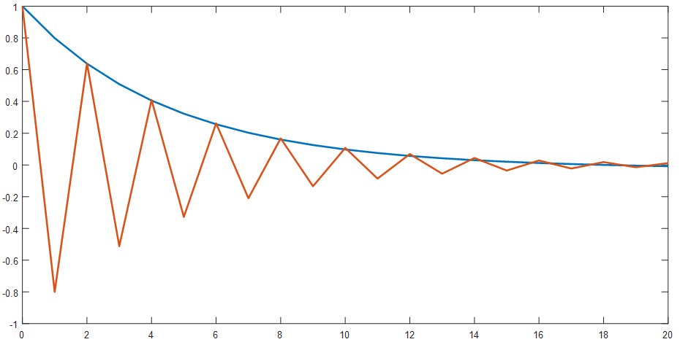

Slide 9
PART 2. MOVING-AVERAGE MODELS AND COMPLEX ARMA MODELS

Slide 10
Moving-Average Model
Moving-Average Model of order q:
MA(q):

Slide 12
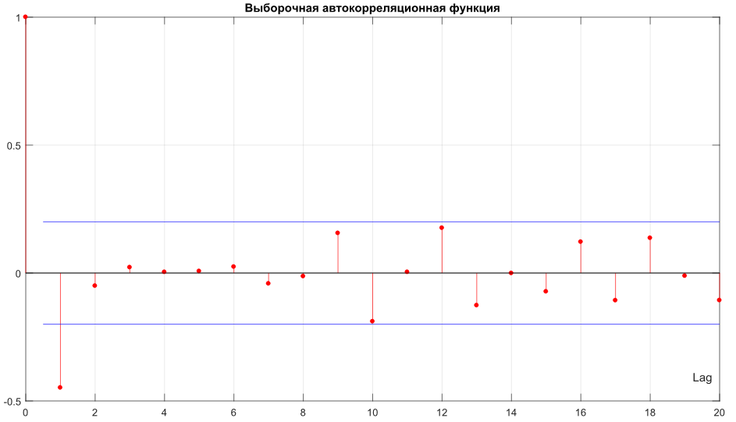

Slide 13
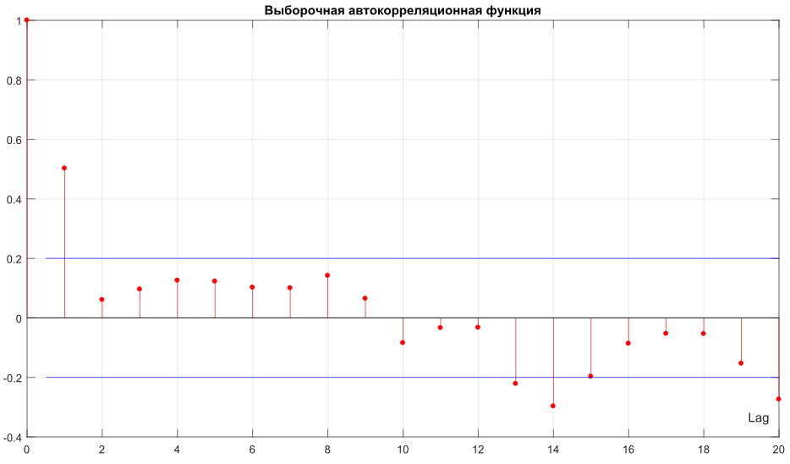

Slide 14
ARMA Mixed Model
Autoregressive – Moving-Average model of order (p,q):
ARMA(p,q):
This is a stationary model

Slide 15
ARIMA Mixed Model
Autoregressive – Integrated Moving-Average model of order(p,d,q):
ARIMA(p,d,q):
The d-difference is a stationary model.

Slide 16
«Integrated»
From the ARIMA definition with shift operators:

Slide 17
PART 3. STATIONARITY criterion FOR ARMA MODELS

Slide 18
ARMA stationarity
If the process is stationary in wide sense, hence its variance is finite and constant;
For ARMA model it means, that generating weighting function:
is a polynomial converging with condition

Slide 19
Characteristic Polynomial
Its roots can be a measure of stationarity;
AR process is a stationary time series,
if its characteristic polynomial have no unit roots, i.e. the roots are situated outside of unit circle

Slide 20
ARMA stationarity
The definition of AR stationary process can be expanded to MA and mixed ARMA models with the help of inverse shift operators in generating weighting function;
Thus, the ARMA stationarity problem is equal to the search of unit roots of corresponding characteristic polynomial;

Slide 21
ARIMA Model
ARIMA has exactly d unit roots:

Slide 22
PART 4. ESTIMATION OF AR MODELS

Slide 23
Autoregressive Model
We need to estimate the coefficients in eq.:
Multiply it with:
AR model is stationary, hence expectation value is zero:

Slide 24
Yule–Walker equations

Slide 25
Yule–Walker equations

Slide 26
Variance of AR model
Yule–Walker equations technique is equivalent to the least-square method for finding linear regression coefficients from known observations:

Slide 27
AR(1) model of the first order

Slide 28
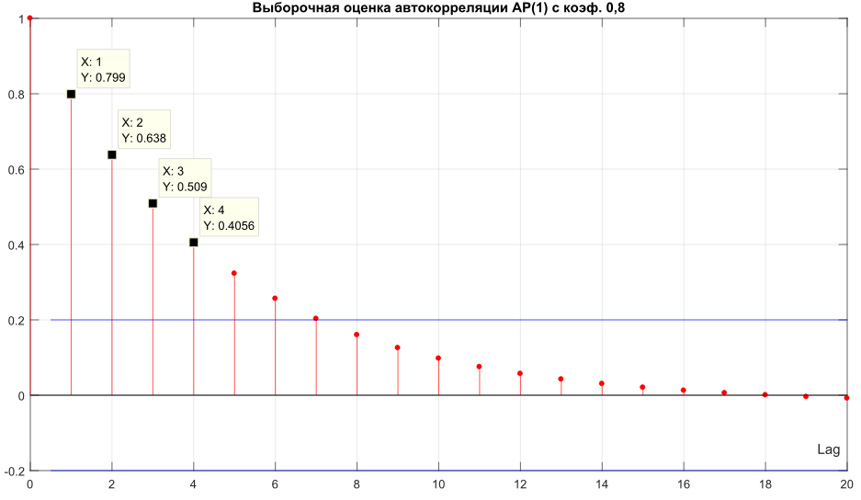

Slide 29
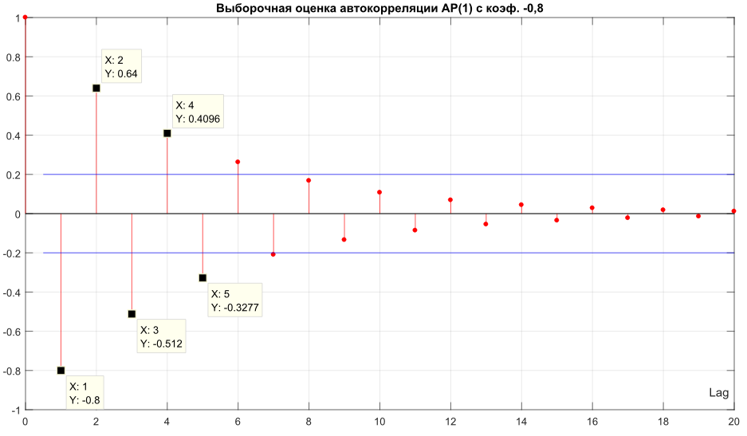

Slide 30
AR(2) model of the second order

Slide 31
AR(p) model of p-order
where – j-coefficient of a partial AR(k) model.
AR(p+1) model coefficients of higher order are estimated recurrently from coefficients of a partial AR(p) low-order models with the Darbin equations;

Slide 32
Darbin Equations

Slide 33
AR(3) model of the third order

Slide 34
PART 5. ESTIMATION OF MA MODELS

Slide 35
Moving-Average Model
We need to estimate the equation:
Multiply with and ensemble average:
hence

Slide 36
MA(1) model of the first order

Slide 37
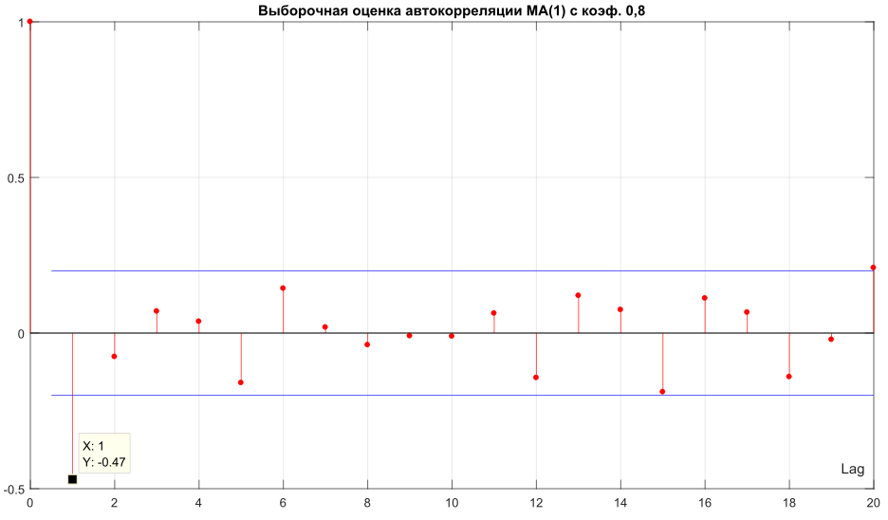

Slide 38
MA(2) model of the second order

Slide 39
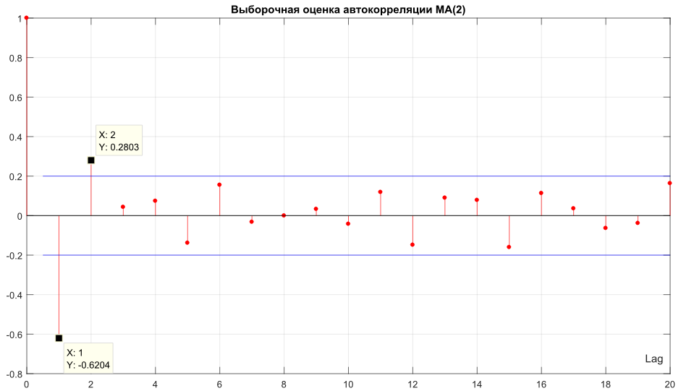

Slide 40
PART 6. ESTIMATION OF ARMA AND ARIMA MODELS

Slide 41
ARMA model estimation
We need to estimate:
Wold representation theorem: every stationary time series can be written as the sum of two time series, one deterministic and one stochastic, with possibly infinite vector of MA or AR weights.
Thus, ARMA (p,q) can be represented, as:
Deterministic process АR(p) with MA(q) noise;
Deterministic process MA(p) with AR(q) noise;

Slide 42
Three methods of ARMA estimation
Infinite vector of MA bounded weights, based on Wold theorem with several conditions;
The least-squares method with AR coefficients from Yule-Walker and Darbin equations;
Conventional method of a highest likelihood;

Slide 43
ARMA model estimation
We can estimate the ARMA(p,q) model coefficients based on AR or MA estimation techniques.
The question is – which is better: based on deterministic AR or deterministic MA?
Wold theorem also gives an answer to this question: infinite vector of moving average MA bounded weights is better

Slide 44
ARIMA (p, d, q) estimation
We need to solve:
When d=0 model is simply ARMA(p, q) model.
With stationarity we can reconfigure
ARIMA(p, d, q) model as ARMA(p+d, q),
with exactly d unit roots.
So, first of all we need to check unit roots statistical tests (to assess the d value), and check for stationarity of time series data.

Slide 45
Box-Jenkins Technique
Usage of statistical tests for time series stationarity and unit root tests;
Estimation of number d unit roots;
Application of Difference Scheme:
and transition from ARIMA to ARMA model

Slide 46
PART 7. GENERAL TECHNIQUE FOR INITIAL ESTIMATION OF ARMA AND ARIMA COEFFICIENTS

Slide 47
Estimation of ARMA coefficients
General process of estimation for ARMA model coefficients is based on the first p+q+1 auto-covariance coefficients
AR parameters are estimated from

Slide 48
Estimation of ARMA coefficients
With newly founded we can estimate q+1 auto-covariance
for the MA part
Then we use these in order to estimate the initial parameters for MA part of model and ARMA variance estimate

Slide 49
Estimation of ARMA coefficients

Slide 50
References
Box G., Jenkins G. Time Series Analysis: Forecasting and Control. — 4th ed. Wiley. — 2008. — 784 p.
Robert H. Shumway, David Stoffer. Time Series Analysis and Its Applications. — Springer Texts in Statistics, 4th ed. — 2016. — 550 p. ISBN 978-3-319-52451-1
Karter J. Time series analysis with MATLAB. ARIMA/VARMAX/GARCH/GJR Models. Functions and Examples. — 2016. — 422 p. ISBN 978-1-539-54638-2.

